Slide 1
The United States During The Space Race
Kamna Talwar
HIST 390 Final

Slide 2
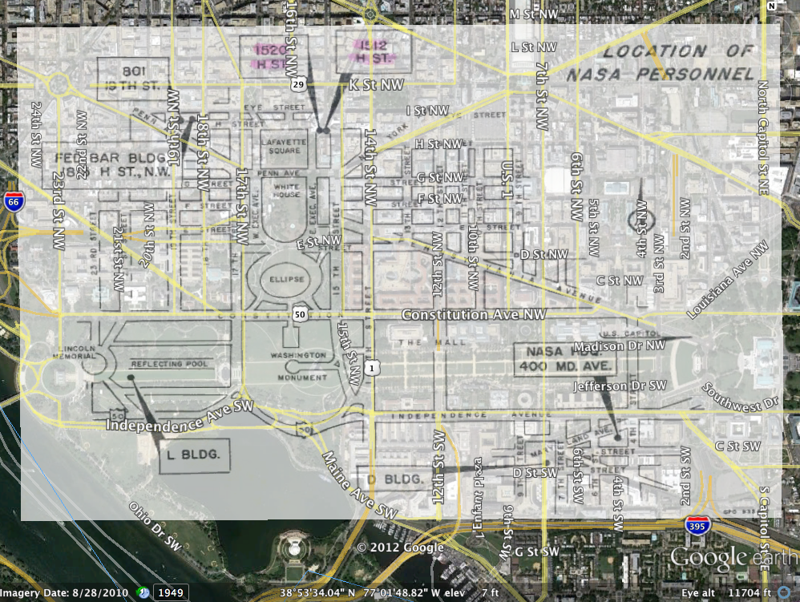
Map Overlay 1
Notes:
Content: This is an overlay of the various NASA buildings in Washington, D.C. in 1962. The presence of many buildings demonstrates the importance of America’s involvement in space exploration.
Process: This overlay was relatively simple to perform. The roads were helpful in the alignment of the overlay on top of the Google Earth image. Of course, it’s not perfect and some buildings, roads, etc. are not accurately overlayed. Nonetheless, this a decent overlay of the two images.

Slide 3
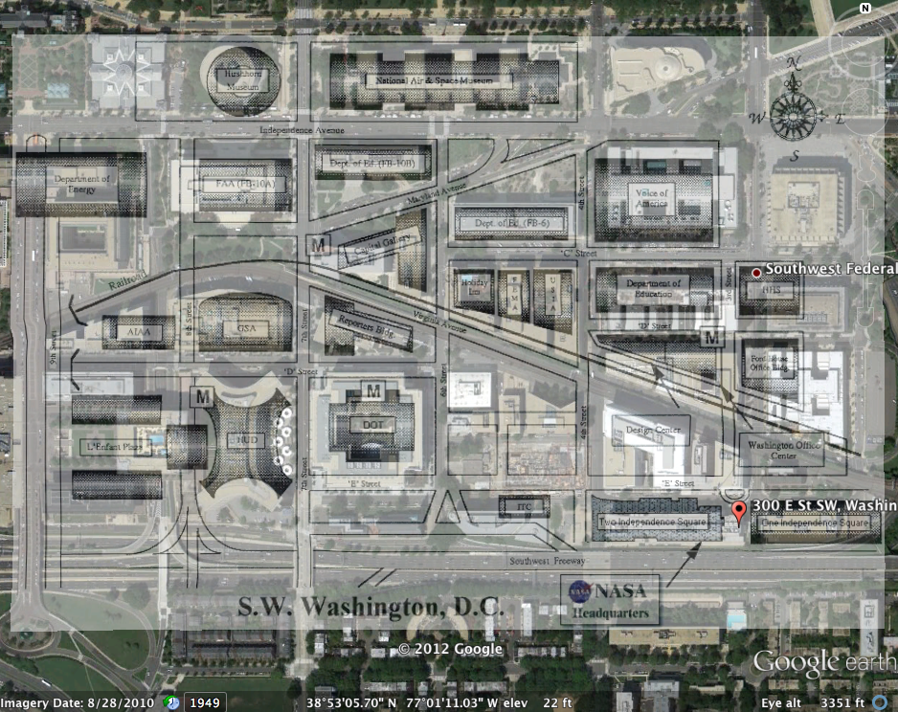
Map Overlay 2
Notes:
Content: This overlay shows the location of NASA headquarters. The location has remained the same. This is most likely due to the fact that expansion of the NASA headquarters building would be nearly impossible in D.C. However, as demonstrated in the previous overlay, there are many more NASA buildings other than the headquarters located at 300 E. St. SW, Washington, D.C., showing the significance of space exploration.
Process: Again, the overlay process was not too difficult. The roads were helpful for this overlay as well. I tried my best to match the roads and buildings from the two images.

Slide 4
Timeline of Space Race
Timeline of Events
Notes:
Content: A timeline of events can be accessed using the link above. The timeline includes major space-related events from 1960-1970. The timeline starts in 1961 with the first man in space and ends in 1969 with the first man on the moon. This ten-year period seemed to be the peak of the Space Race. A key feature of the timeline is the inclusion of countries who got credit for the events, further demonstrating competition between America and the USSR during the Space Race.
Process: The tool used to create the timeline is a free, online site called Timetoast. The site is incredibly helpful and easy to use! After creating an account, I could immediate create my timeline. The navigation is simple, the process is straightforward, and the outcome looks professional.

Slide 5
Google Ngram Visualization
Notes:
Content: “space exploration” vs. “space race” is visible in this Ngram. Notice peaks of both terms in the mid-1960s. This time period is the height of the Space Race. It makes sense that a more generic term like “space exploration” has more hits than “space race.” An interesting part of the Ngram is the increase of usage of both terms in the early 2000s.
Process: I really like Google Ngram, so it was difficult for me to choose just one visualization for the project. There are so many words that could be used for this assignment. However, it was easy once I decided which words to compare. “Space Race” (with that specific capitalization) was not as prevalent as “space race” (with that specific capitalization). For this reason, I only compared “space race” to “space exploration.”

Slide 6
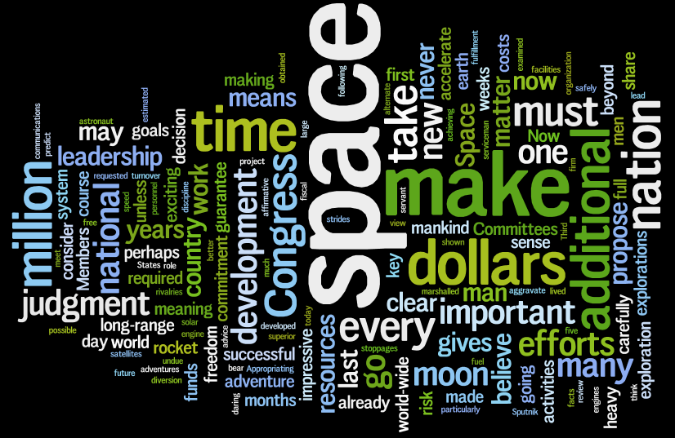
Wordle
Notes:
Content: This Wordle is composed of section 9 of President Kennedy’s address to Congress on May 25, 1961. The entire section is titled and devoted to space. It’s no surprise that the word “space” is the largest and most visible word here. Some other words, such as “moon,” “nation,” and “time” raise interest. “Time” refers to the Space Race itself. The importance of America’s place in the race is clearly evident with words like “nation,” “national,” and “country.” “Moon” is obviously significant because it was in this address that President Kennedy officially began the so-called “Moon Race.” In this address he states, “I believe that this nation should commit itself to achieving the goal, before this decade is out, of landing a man on the moon and returning him safely to the earth.”
Process: I enjoy Wordle representations and I thought this address to Congress was a perfect fit for such a representation because of it’s significance in the Space Race.

Slide 7
Textual Analysis: Statement 1
April 12, 1961: Statement by the President on the Orbiting of a Soviet Astronaut.
“THE ACHIEVEMENT by the USSR of orbiting a man and returning him safely to ground is an outstanding technical accomplishment. We congratulate the Soviet scientists and engineers who made this feat possible. The exploration of our solar system is an ambition which we and all mankind share with the Soviet Union and this is an important step toward that goal. Our own Mercury man-in-space program is directed toward that same end.”
The last sentence of this statement is the most significant sentence in the context of this project because, although Kennedy is congratulating the USSR’s achievement, he is still persistent in the United States’ involvement in the Space Race.
Notes:
Content: See analysis above.
Process: In the context of this project, the beginning of the peak of the Space Race started with Yuri Gagarin’s orbit in space. Naturally, the American president’s response to such an event is highly significant. The most noteworthy piece of the statement, as mentioned above, is the last sentence. This stuck out to me, and that’s why I included this particular statement in this project.

Slide 8
Textual Analysis: Statement 2
May 5, 1961: Statement by the President on the Flight of Astronaut Alan B. Shepard.
“ALL AMERICA rejoices in this successful flight of Astronaut Shepard. This is an historic milestone in our own exploration into space. But America still needs to work with the utmost speed and vigor in the further development of our space program. Today's flight should provide incentive to everyone in our nation concerned with this program to redouble their efforts in this vital field. Important scientific material has been obtained during this flight and this will be made available to the world's scientific community. We extend special congratulations to Astronaut Shepard and best wishes to his family who lived through this most difficult time with him. Our thanks also go to the other Astronauts who worked so hard as a team in this project.”
There are two parts of this statement that are pertinent to America’s involvement in the Space Race. First is the sentence about the need to continue and further the advancement of America’s space program. The second is the global impact of this event, especially on the USSR.
Notes:
Content: Although proud of Shepard, Kennedy is sure to show his dedication to progress in the field of space exploration.
Process: This statement also stuck out to me. I found it peculiar that Kennedy looks at this grand feat as merely a stepping stone to further progress. This speaks volumes about his persistence to “winning” the Space Race. The last sentence of the first paragraph further shows this motive because Kennedy mentions the “world’s scientific community.”

Slide 9
Sources
Google Ngram
Timetoast Tool
http://timetoast.com/
John F. Kennedy’s Public Papers
General link: http://www.jfklink.com/speeches/jfk/publicpapers/1961/jfk_contents_papers1961.html Statement 1: http://www.jfklink.com/speeches/jfk/publicpapers/1961/jfk117_61.html Statement 2: http://www.jfklink.com/speeches/jfk/publicpapers/1961/jfk170_61.html Address to Congress: http://www.jfklink.com/speeches/jfk/publicpapers/1961/jfk205_61.html
Space Race Website
Timeline: http://www.thespacerace.com/timeline/
“Hidden Headquarters” Presentation by Elizabeth Suckow
Overlay 1: http://hqoperations.hq.nasa.gov/docs/Hidden_Headquarters_March_24_2009.pdf
NASA Website
Overlay 2: http://www.nasa.gov/centers/hq/about/map.html
Notes:
That’s all, folks! ;)

