Slide 1
Cotton Candy
a brief history

Slide 2
Cotton candy
is composed of sugar, air, and food coloring (as desired).

Slide 3
History
First recorded in the 16th century
First machine was invented by William Morrison and John C. Wharton in 1897
Popularized by the 1904 World’s Fair
known as “Fairy Floss”
Most recent machines are from 1970 to now

Slide 4
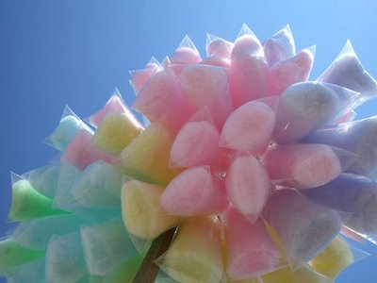
Fun Fact!
Cotton Candy day is celebrated on December 7 in the USA

